Slide 1
The Collapse of the American Dream:
From “Rags to Riches” to the “Ragged and the Rich”
John Wu, Connie Lu, Smriti Vijay, Gwen Gao, Alvin Li
Notes:
1: Gwen, 2: Alvin, 3: Violet, 4&5: Connie, 6: Violet, 7&8: Smriti

Slide 2
“Knowledge is Power. Information is Liberating. Education is the premise of Progress, in every society, in every family.”
—Kofi Annan
Ghanaian diplomat and former Secretary General of the United Nations
Notes:
If needed to cut down on slide count lets say out loud

Slide 3
01
Our Question
Purpose
Testing the accuracy of the current American Dream providing a better life.
Measuring how minimizing economic inequality can increase social stability and wellbeing, maximize educational opportunities, etc.
Knowing what contributes to vertical social mobility to guide American policies to restore American Dream & help with key issues.
How has the promise of the American Dream changed over time and how can America learn from other countries to improve its social mobility?
Notes:
Gwen - define american dream

Slide 4

Methodology
Selecting Data
Finding datasets from various sources to cast a wide net in seeing what variables affect our response variables.
EDA & Cleaning
Join together the data and plot variables to visualize correlations, subset for only rows of non-NA observations, apply log transformation to GDPPC
Analysis
Model Creation
Creating LM, LASSO, Relaxed LASSO, Tree, Random Forest, & XGBoost models for Social Mobility Index, Poverty Rate, & GDP Per Capita.
Selecting predictive models based on testing error, explainability, and overall model significance.
Model Selection & Prediction
Notes:
Explain why we choose to apply log transformation to GDPPC: due to the nature of GDPPC having extreme polarity, we can expect a multiplicative change in the output over an additive change in the input - thus by transforming we allow for more accurate models with lower error.
We chose to subset because most models require no NA values and to split training and testing data
Log transformation for normality

Slide 5
02
US Data
Analyzing the Current US State
Notes:
Alvin

Slide 6
US Data
Median Income
FRED
Medicare Monthly Premiums The Balance
Tuition Fees
NCES
Share of Wealth by Top 1% v.s. Bottom 50%
FRED
House Price FRED
GINI Index
FRED
Percent of Children that Earn More than Parents
Opportunity Insights
Savings After Necessary
Expenditures
FRED
Notes:
Explain the less commonly understood variables like GINI Index (The Gini index measures the extent to which the distribution of income or consumption among individuals or households within an economy deviates from a perfectly equal distribution. A Gini index of 0 represents perfect equality, while an index of 100 implies perfect inequality.) and Savings after necessary Expenditures,
FRED - Federal Reserve Economic Data, NCES - National Center of Educational Statistics

Slide 7
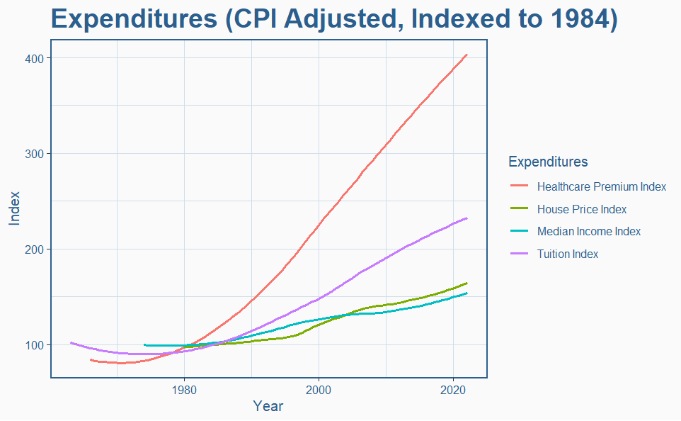
Notes:
This a visualization of Healthcare Monthly premiums, house price, median income, and tuition fees first cpi-adjusted to account for inflation and then indexed to 100 to the year 1984 to show the real percent change.

Slide 8
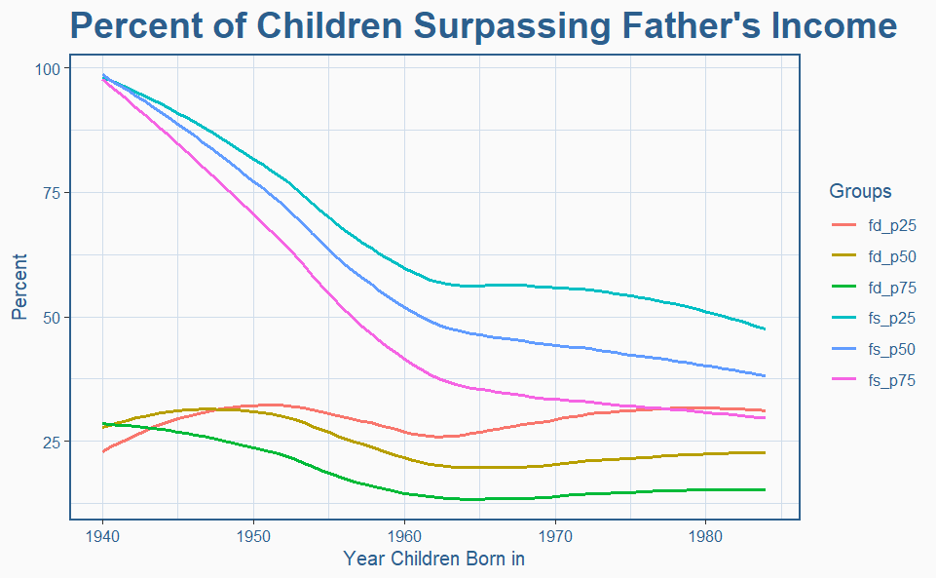
Notes:
Explain that in the legend, fd means a father daughter pair, and fs means a father son pair. The next number represents the percentile that the father’s income was at, for example p50 was 50th percentile.

Slide 9
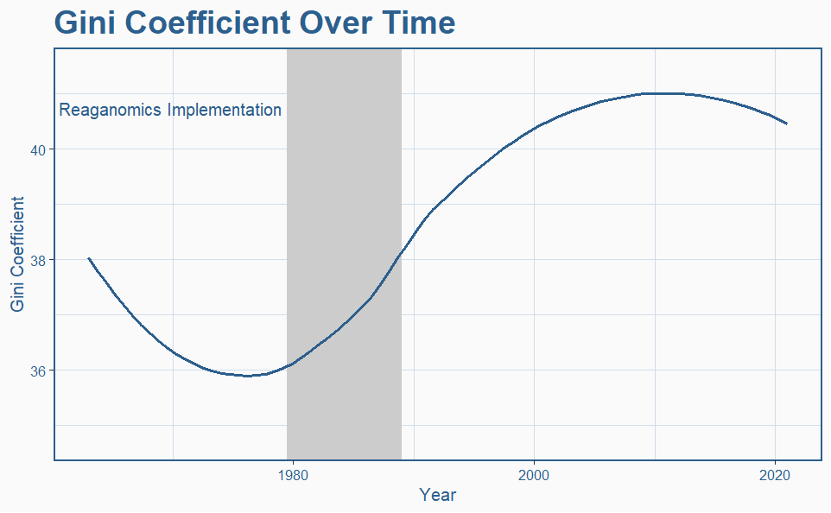

Slide 10
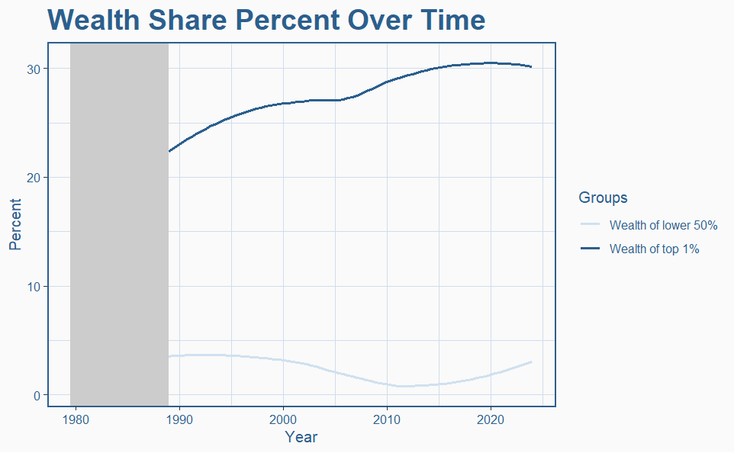

Slide 11
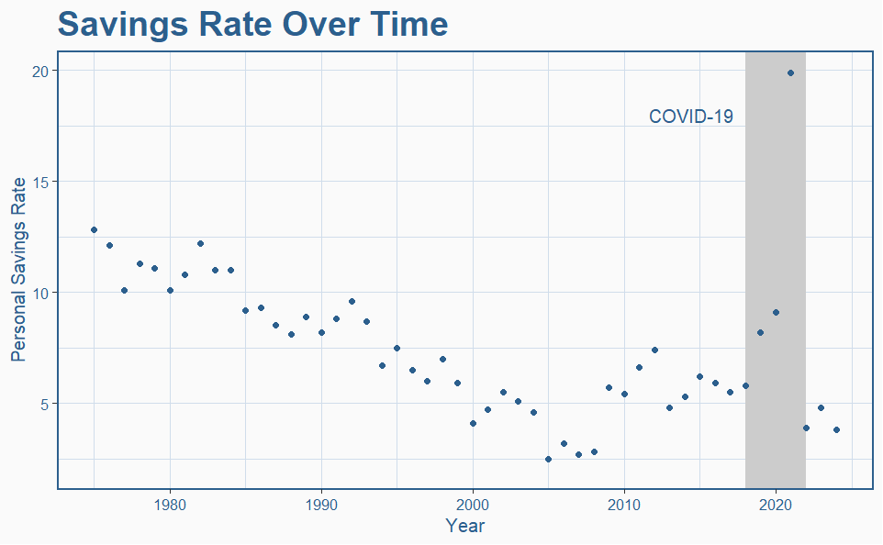

Slide 12
03
Global Data
Modeling and Predicting Impacts on Poverty, Social Mobility, and GDP Per Capita
Notes:
Smriti

Slide 13
Global Data
Mortgage as %
of Income
World Population Review
Tuition Costs
N26
Price to Income Ratio
World Population Review
Social Welfare
OECD
Top 1% Income Share
Our World In Data
Gini Coefficient
Statista + World Bank
Education Index
World Population Review
Corruption Perception Transparency International
Healthcare Index
Numbeo
Notes:
Explain each variable that people don’t understand: Social Welfare is the social Welfare as a % of total GDP, House Affordability Index is the inverse of mortgage as a % of Income, where higher values are preferable. Price to Income Ratio is similar but distinct - it is a measure of the apartment purchase affordability, where a lower ratio is preferred. The Gini coefficient is the same as before. Health Care Index is an estimation that evaluates the overall quality and accessibility of the healthcare system, including factors such as healthcare professionals, equipment, staff, doctors, and costs. Education Index measures the quality of education of a country based off of the access to education, cultural values and emphasis on education, and economic standing, where higher values are preferred. Finally, corruption perception Index ranks countries based off of perceived transparency and corruption in government, where 0 is very corrupt and 100 is very clean.

Slide 14
Predicted Variables
GDP Per Capita
WorldOMeter
Poverty Rate
OECD
Social Mobility Index
World Economic Forum
Notes:
Explain the variables and why we chose to sue them to predict:
Social Mobility Index measures vertical social mobility, as the name implies, based off of several measures including but not limited to education access and quality, working conditions, fair wage distribution, and how many generations for a low income household to approach mean income.
Poverty Rate and GDP Per Capita are strong indicators of a country’s overall prosperity and are key topics of debate regarding socio economic policy.
Thus, we choose these three as models for explaining the major factors that go into these variables for a given country as well as predicting what these values will be for new models.

Slide 15
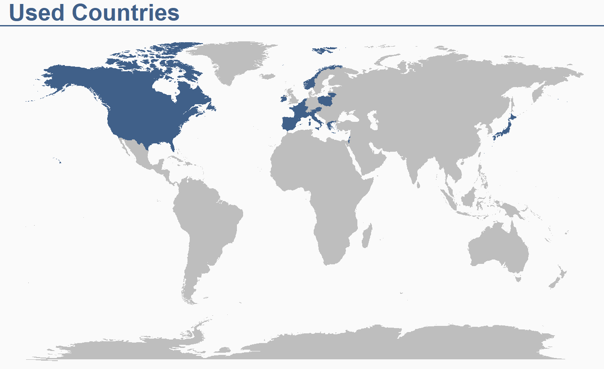
Used Countries
Notes:
Norway" "Finland" "Sweden" "Netherlands" "Belgium" "Austria"
[7] "Luxembourg" "France" "Slovenia" "Canada" "Japan" "Ireland"
[13] "United Kingdom" "Estonia" "Portugal" "Lithuania" "United States" "Spain"
[19] "Poland" "Latvia" "Israel" "Italy" "Hungary" "Greece"

Slide 16
04
Model Selection
Choosing Predictive Models
Notes:
Smriti

Slide 17
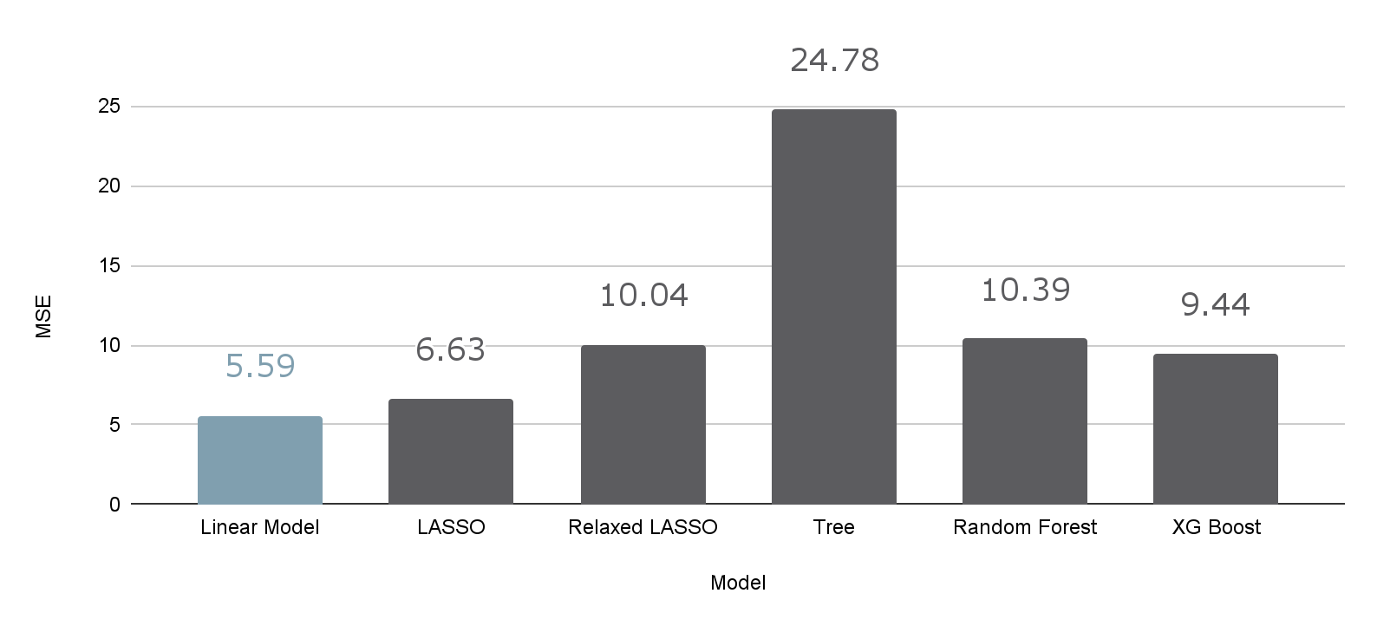
Comparing Social Mobility Index Models
Final Model
Other
Notes:
Include within testing data

Slide 18
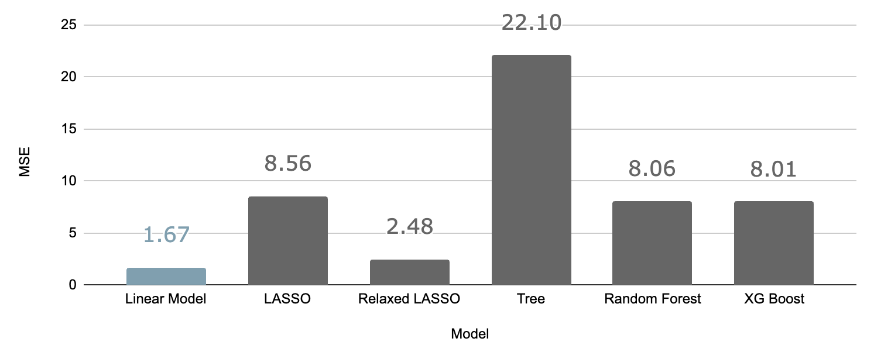
Comparing Poverty Rate Models
Final Model
Other

Slide 19
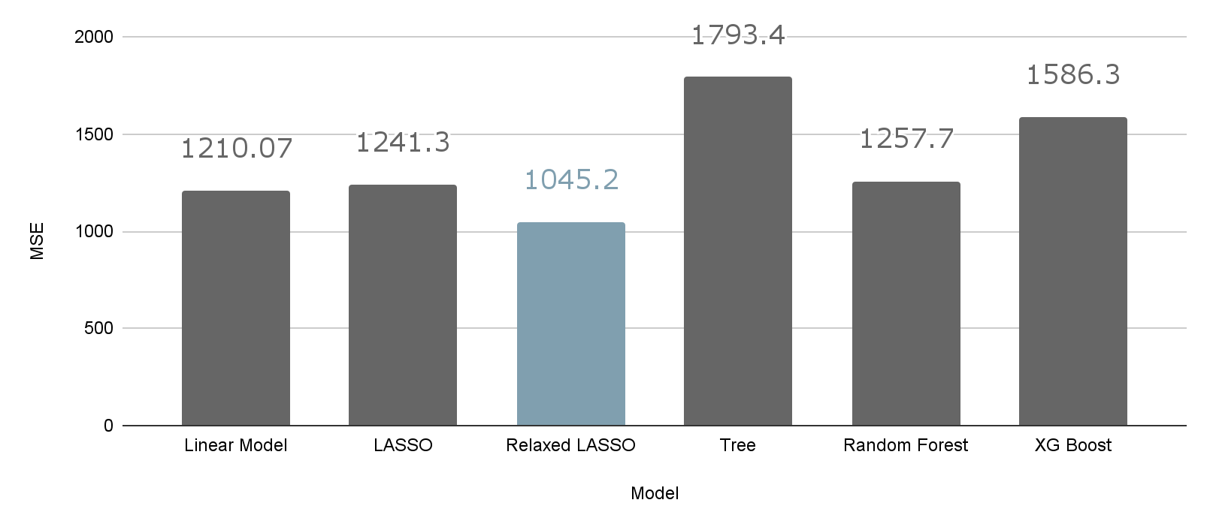
Comparing Log GDP Per Capita Models
Final Model
Other
Notes:
Error here in pictured here in USD, linear model vs r lasso, it was more explainable (p-values were better, rlasso does not optimize p-values) + errors were very similar

Slide 20
05
Final Models
Analysis of Our Final Models
Notes:
Connie

Slide 21
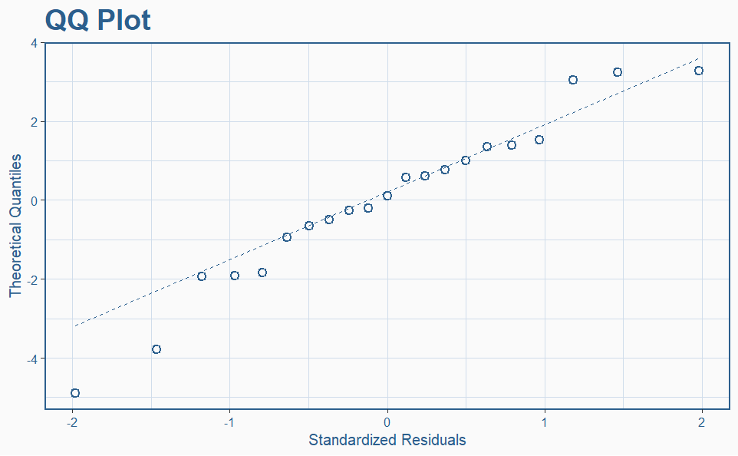
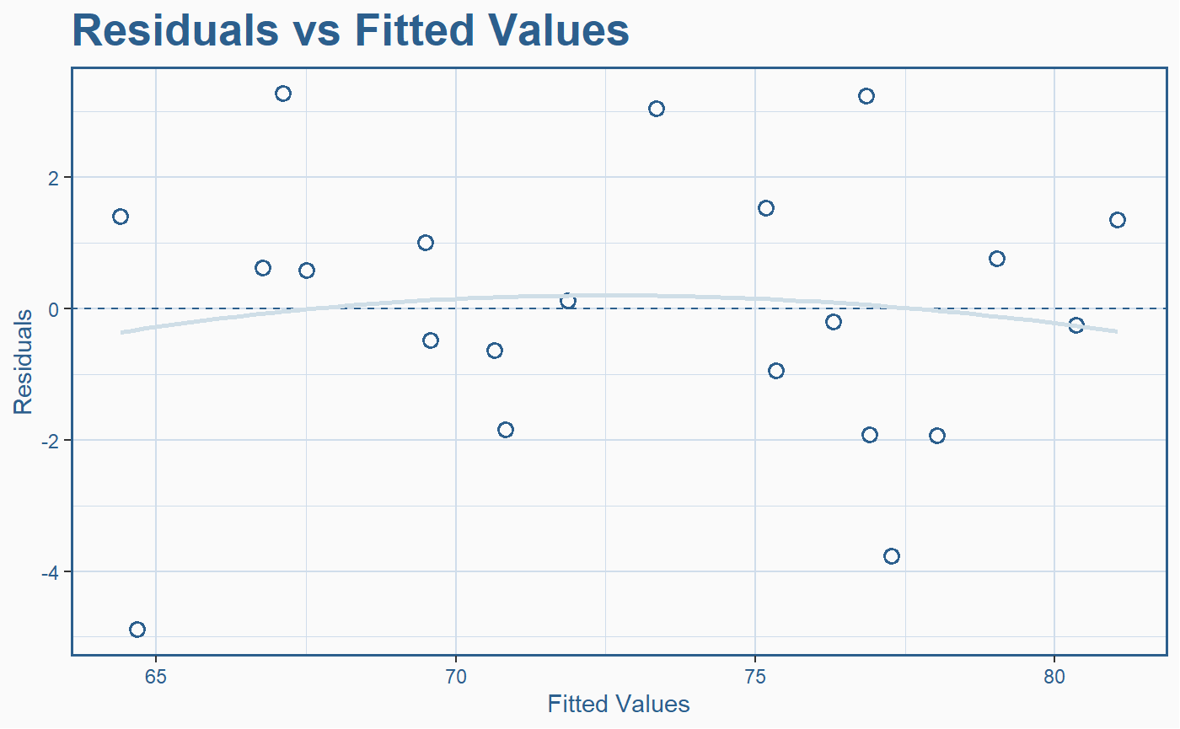
Social Mobility Index Linear Model
 | Coefficient | 95% CI | P-value
Intercept | 61.67396 | 49.992, 73.356 | 0.00000000312
Wealth Share Top 1% | -0.7033 | -0.922, -0.059 | 0.0284
Gini Coefficient | 0.2004 | -69.035, -1.267 | 0.0429
Corruption Perception | 1.5556 | 0.332, 0.541 | 0.007
Multiple R-squared: 0.856 Adjusted R-squared: 0.831
F-statistic: 33.67 on 3 and 17 DF P-value: 0.0000002256
Notes:
Also, talk about each coefficient and the significance, assumptions met/unmet
For significance that are close to .05 but not quite there, we can say that although we are not 95% confident it has a positive/negative effect, since they are still .1 significant we have a 90% confidence interval that it has a positive/negative effect.
We know correlation is positive for health care and housing affordability, p value tells us we dont know if that correlation matters

Slide 22
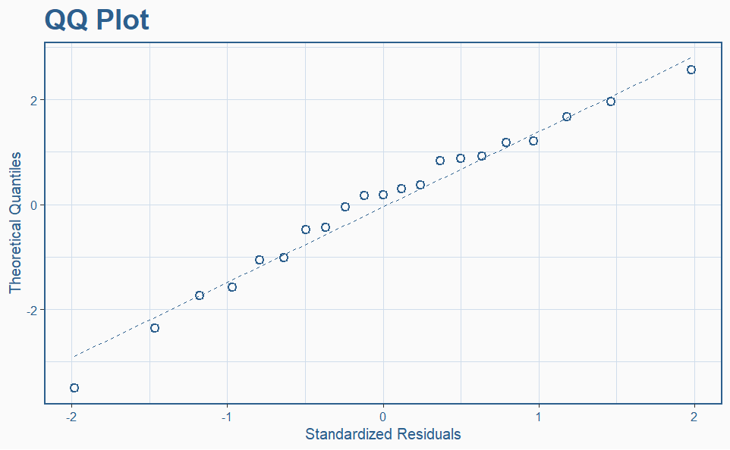
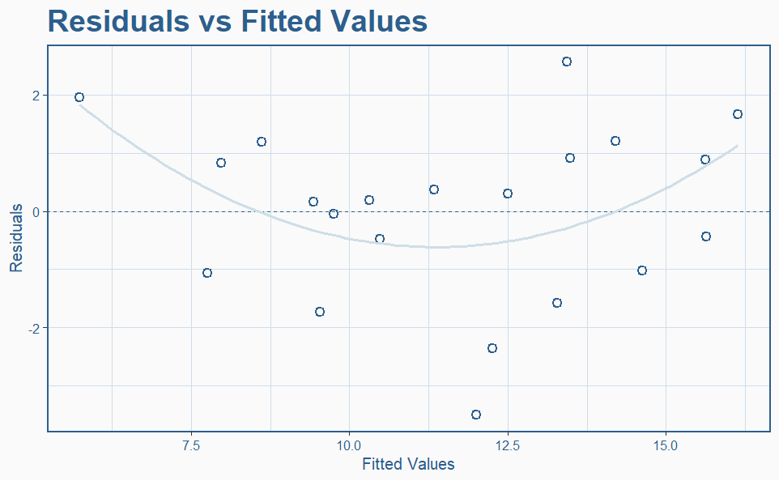
Poverty Rate Linear Model
 | Coefficient | 95% CI | p-value
Intercept | -1.2962 | -12.89, 10.29 | 0.8162
Health Care Index | 0.1697 | 0.033, 0.307 | 0.0181
Wealth Share Top 1% | 0.5566 | 0.175, 0.939 | 0.0068
Welfare Spending % GDP | -0.2588 | -0.520, 0.002 | 0.0518
Multiple R-squared: 0.5375 Adjusted R-squared: 0.4559
F-statistic: 6.585 on 3 and 17 DF P-value: 0.00374
Notes:
We chose these 8 variables to change for each prediction; after having seen through our models that Tuition costs had low correlation with our response variables and were rarely significant. We chose our values based off of other countries’ real values in these variables, and created 3 different changed Americas to predict off of: 1, 2, and 3 representing a midball improvement, a best case scenario, and a worst case scenario respectively. It should be noted each model does not use all 8 variables.
Intercept not significant, but our overall model p value is good

Slide 23
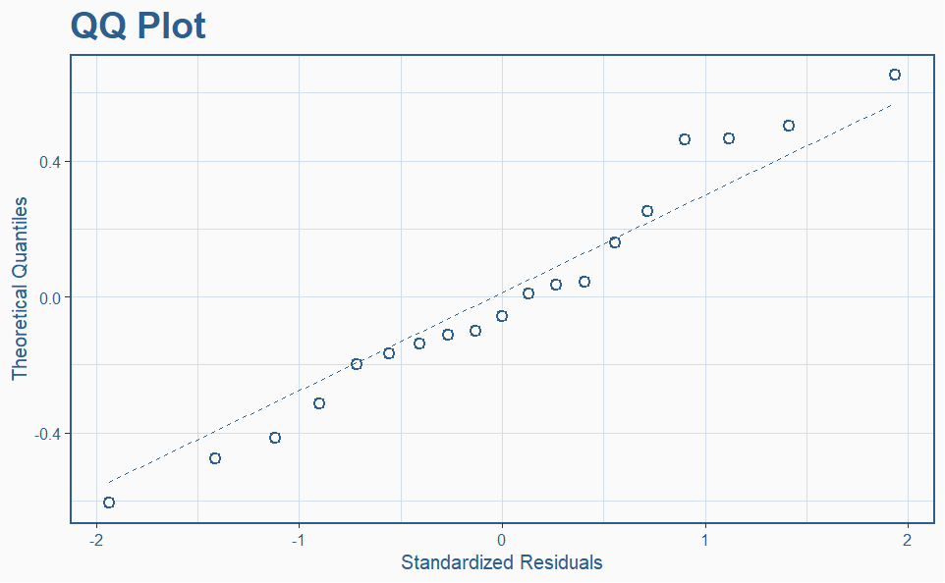
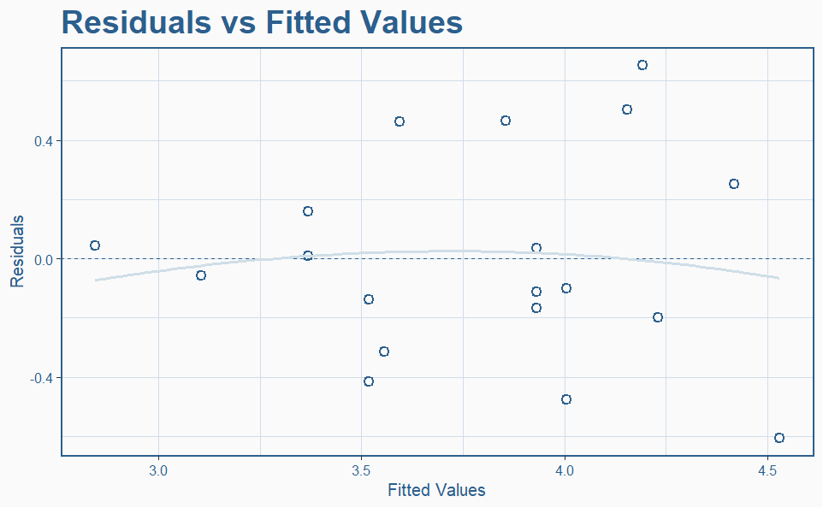
Log GDP Per Capita Relaxed LASSO
 | Coefficient | 95% CI | p-value
Intercept | 1.268648 | 0.243, 2.294 | 0.0183
Corruption Perception | 0.037489 | 0.022, 0.053 | 0.00000629
Multiple R-squared: 0.6201 Adjusted R-squared: 0.5977
F-statistic: 27.75 on 1 and 17 DF P-value: 0.00006286
Notes:
We chose these 8 variables to change for each prediction; after having seen through our models that Tuition costs had low correlation with our response variables and were rarely significant. We chose our values based off of other countries’ real values in these variables, and created 3 different changed Americas to predict off of: 1, 2, and 3 representing a midball improvement, a best case scenario, and a worst case scenario respectively. It should be noted each model does not use all 8 variables.

Slide 24
06
Predictions
Our Predicted Values
Notes:
Violet

Slide 25
Prediction Data
 | Original | Prediction 1 (Low) | Prediction 2 (Mid) | Prediction 3 (High)
Corruption Perception: | 69 | 58.5 | 79.5 | 90
Gini Coefficient: | 0.41 | 0.5 | 0.32 | 0.23
Health Care Index: | 68 | 58.8 | 77.2 | 86.4
Welfare spending % gdp: | 18.70% | 12.45% | 0.2495 | 31.20%
Income share top 1%: | 20.90% | 27.90% | 0.139 | 6.90%
Notes:
We chose these 8 variables to change for each prediction; after having seen through our models that Tuition costs had low correlation with our response variables and were rarely significant. We chose our values based off of other countries’ real values in these variables, and created 3 different changed Americas to predict off of: 1, 2, and 3 representing a midball improvement, a best case scenario, and a worst case scenario respectively. It should be noted each model does not use all 8 variables.

Slide 26
Prediction Results
Limits | SMI.R | SMI.1 | SMI.2 | SMI.3 | POV.R | POV.1 | POV.2 | POV.3 | GDP.R | GDP.1 | GDP.2 | GDP.3
Pred. | 70.4 | 55.9 | 78.7 | 89.4 | 15.2 | 21.0 | 14.5 | 9.1 | 75.3 | 31.9 | 70.0 | 103.8
Low. | X | 49.8 | 75.4 | 85.7 | X | 14.8 | 10.48 | 5.9 | X | 25.6 | 54.4 | 70.8
Upp. | X | 62.1 | 82.1 | 93.3 | X | 25.6 | 13.3 | 12.4 | X | 39.6 | 90.1 | 152.1
Notes:
SMI represents Social Mobility Index, POV is poverty rate, GDP is GDP per Capita in Thousands USD, .R means real values, pred. Means predicted, upp. Means 95% upper confidence interval, low. Means 95% lower confidence interval.

Slide 27
07
Discussion
Suggestions & Potential Policies

Slide 28
How Can We Improve?
Healthcare
Income Share of 1% / GINI
Increased Funding & government assistance
Lower Costs for easier access
Less privatization and caps on pharmaceuticals
Progressive taxation
Improved/Livable wages
Erase avoidance loopholes
Welfare Spending as % of GDP
Corruption Perception
Minimize social stigma and administrative hassle
Divert funding in budget
Full transparency for public discussion
Institutional reform
Openness regarding spending & lobbying

Slide 29
Limitations
Small training sample size of 24 countries led to higher error and limited predictive power
Ex: Welfare Spending as % of GDP
Mostly high-income countries and excluded those outside large international orgs like OECD with limited public information
With more data, we could improve our models to produce more accurate insights on our variables
Some data points were not up-to-date

Slide 30
References
Board of Governors of the Federal Reserve System (US). (1989a, July 1). Share of Total Net Worth Held by the Bottom 50% (1st to 50th Wealth Percentiles). FRED, Federal Reserve Bank of St. Louis. https://fred.stlouisfed.org/series/WFRBSB50215
Board of Governors of the Federal Reserve System (US). (1989b, July 1). Share of Total Net Worth Held by the Top 1% (99th to 100th Wealth Percentiles). FRED, Federal Reserve Bank of St. Louis. https://fred.stlouisfed.org/series/WFRBST01134
Data. (2018, July 24). Opportunity Insights. https://opportunityinsights.org/data/?geographic_level=0&topic=0&paper_id=546#resource-listing
Digest of Education Statistics,. (n.d.). Nces.ed.gov. https://nces.ed.gov/programs/digest/d23/tables/dt23_330.10.asp
FRED. (2016). GINI Index for the United States. Stlouisfed.org. https://fred.stlouisfed.org/series/SIPOVGINIUSA
FRED. (2018). Real Median Personal Income in the United States. Stlouisfed.org. https://fred.stlouisfed.org/series/MEPAINUSA672N
FRED. (2023). Consumer Price Index for All Urban Consumers: All Items. Stlouisfed.org. https://fred.stlouisfed.org/series/CPIAUCSL
Here’s Why Medicare Part B Premiums Have Increased Over Time. (n.d.). The Balance. Retrieved August 1, 2024, from https://www.thebalancemoney.com/current-and-historical-medicare-part-b-premiums-2388483
U.S. Bureau of Economic Analysis. (1947, January 1). Personal saving as a percentage of disposable personal income. FRED, Federal Reserve Bank of St. Louis. https://fred.stlouisfed.org/series/A072RC1Q156SBEA
U.S. Federal Housing Finance Agency. (1975, January 1). All-Transactions House Price Index for the United States. FRED, Federal Reserve Bank of St. Louis. https://fred.stlouisfed.org/series/USSTHPI
Degenhard, J. (2021, July 20). Gini index worldwide 2020, by country. Statista. https://www.statista.com/forecasts/1171540/gini-index-by-country
Income share of the richest 1% (before tax). (n.d.). Our World in Data. Retrieved August 1, 2024, from https://ourworldindata.org/grapher/income-share-top-1-before-tax-wid?tab=table&time=1820..latest
Numbeo. (2023). Health Care Index by Country 2019 Mid-Year. Numbeo.com. https://www.numbeo.com/health-care/rankings_by_country.jsp
Poverty rate. (n.d.). OECD. Retrieved August 1, 2024, from https://www.oecd.org/en/data/indicators/poverty-rate.html?oecdcontrol-0ad85c6bab-var1=CHE%7CSWE
Social Mobility by Country 2021. (n.d.). Worldpopulationreview.com. https://worldpopulationreview.com/country-rankings/social-mobility-by-country
The Education Price Index 2022 — a Study by N26. (n.d.). N26.com. https://n26.com/en-eu/the-education-price-index
Transparency International. (2024). 2023 Corruption Perceptions Index. Transparency.org; Transparency International. https://www.transparency.org/en/cpi/2023
Wikipedia Contributors. (2019, September 6). List of countries by social welfare spending. Wikipedia; Wikimedia Foundation. https://en.wikipedia.org/wiki/List_of_countries_by_social_welfare_spending
World Population Review. (2021). Education Index by Country 2023. Worldpopulationreview.com. https://worldpopulationreview.com/country-rankings/education-index-by-country
Worldometer. (2023). GDP by Country. WorldoMeters. https://www.worldometers.info/gdp/gdp-by-country/

Slide 31
Thank You

